Slide 1
Logarithmic Differentiation

Slide 2
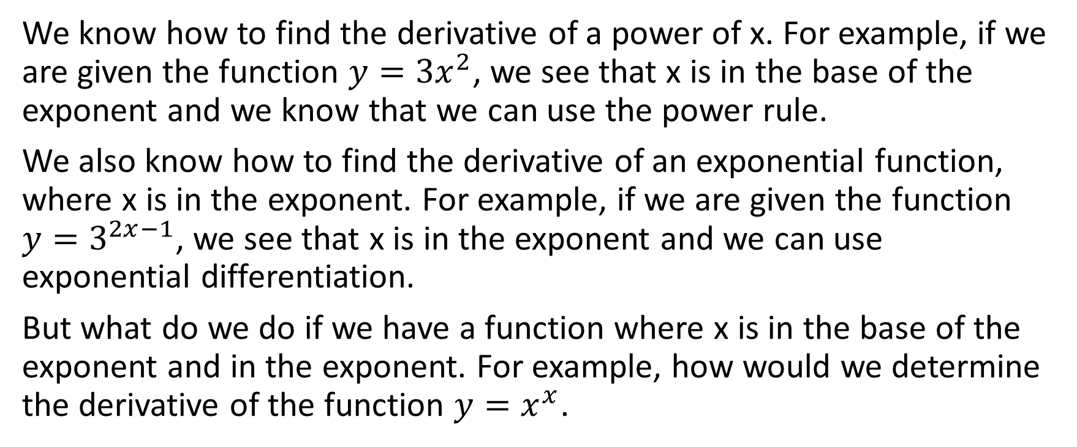
We know how to find the derivative of a power of x. For example, if we are given the function $y={3x}^{2}$, we see that x is in the base of the exponent and we know that we can use the power rule.
We also know how to find the derivative of an exponential function, where x is in the exponent. For example, if we are given the function $y=3^{2x−1}$, we see that x is in the exponent and we can use exponential differentiation.
But what do we do if we have a function where x is in the base of the exponent and in the exponent. For example, how would we determine the derivative of the function $y=x^{x}$.

Slide 3

If we have a power with x in both the base of the exponent and in the exponent itself, we can determine the derivative by taking the natural logarithm (i.e., ln) of both sides, then using previously learned rules of derivatives such as implicit differentiation and the power rule, among others, to isolate $y^{′}$ and thus determine the derivative.

Slide 4

Example
Determine the derivative with respect to x of $y=x^{x}$

Slide 5
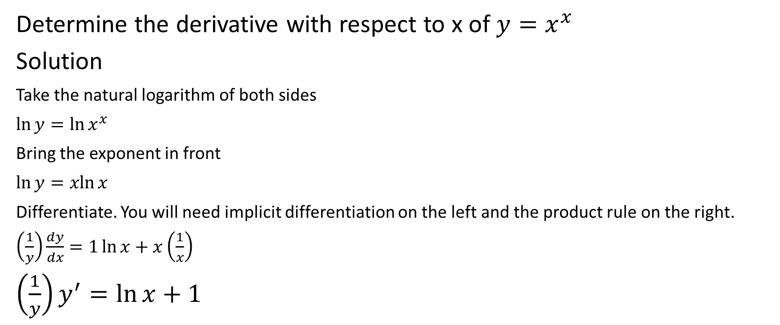
Determine the derivative with respect to x of $y=x^{x}$
Solution
Take the natural logarithm of both sides
$\ln{y=\ln{x^{x}}}$
Bring the exponent in front
$\ln{y=\operatorname{xln}{x}}$
Differentiate. You will need implicit differentiation on the left and the product rule on the right.
$\left(\frac{1}{y}\right)\frac{dy}{dx}=1\ln{x+x\left(\frac{1}{x}\right)}$
$\left(\frac{1}{y}\right)y^{′}=\ln{x+1}$

Slide 6

Determine the derivative with respect to x of $y=x^{x}$
Solution
$\left(\frac{1}{y}\right)y^{′}=\ln{x+1}$

Slide 7
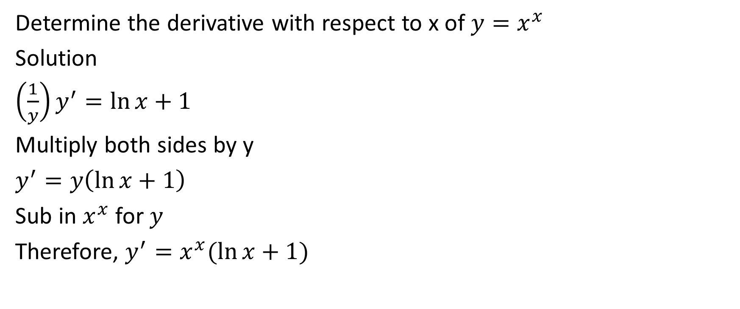
Determine the derivative with respect to x of $y=x^{x}$
Solution
$\left(\frac{1}{y}\right)y^{′}=\ln{x+1}$
Multiply both sides by y
$y^{′}=y\left(\ln{x+1}\right)$
Sub in $x^{x}$ for $y$
Therefore, $y^{′}=x^{x}(\ln{x+1)}$

Slide 8

Example
Determine the derivative with respect to x of $y={(3x+4)}^{x^{4}−2x}$

Slide 9
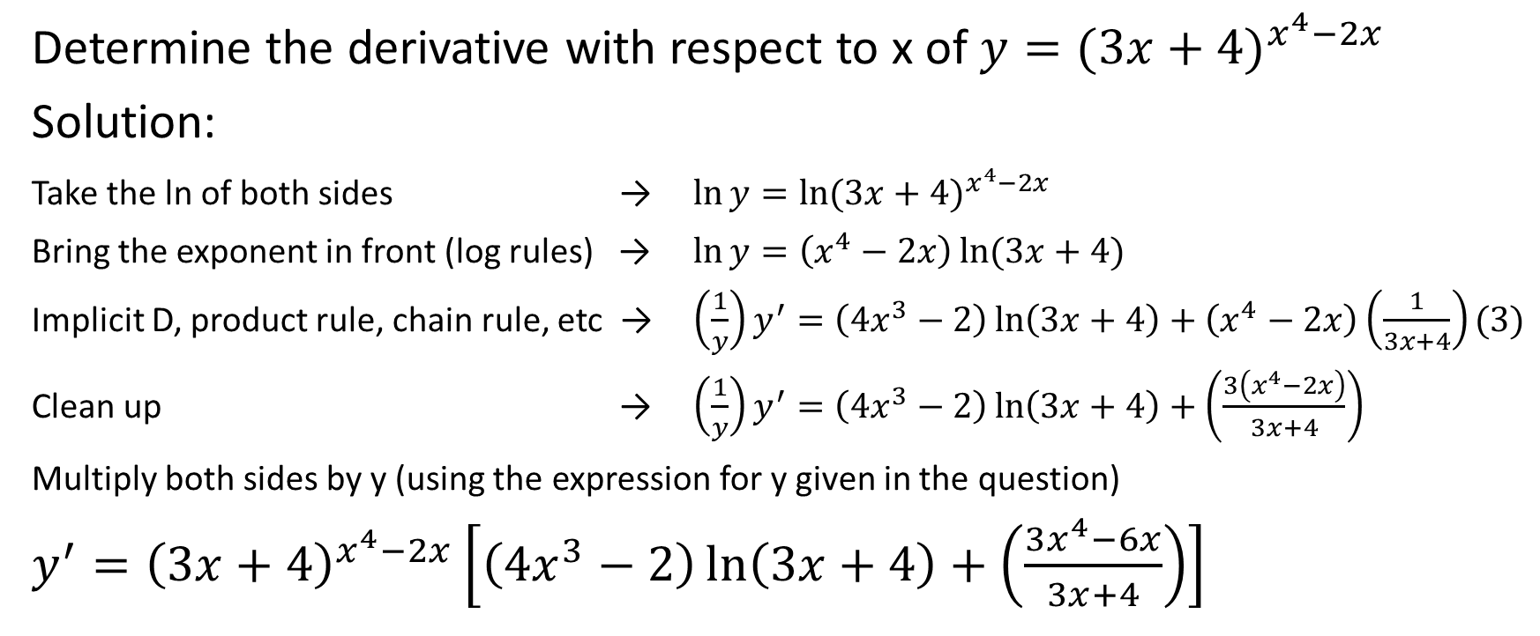
Determine the derivative with respect to x of $y={(3x+4)}^{x^{4}−2x}$
Solution:
Take the ln of both sides → $\ln{y=\ln{{(3x+4)}^{x^{4}−2x}}}$
Bring the exponent in front (log rules) → $\ln{y=\left(x^{4}−2x\right)\ln{(3x+4)}}$
Implicit D, product rule, chain rule, etc → $\left(\frac{1}{y}\right)y^{′}=\left({4x}^{3}−2\right)\ln\left(3x+4\right)+\left(x^{4}−2x\right)\left(\frac{1}{3x+4}\right)(3)$
Clean up → $\left(\frac{1}{y}\right)y^{′}=\left({4x}^{3}−2\right)\ln\left(3x+4\right)+\left(\frac{3\left(x^{4}−2x\right)}{3x+4}\right)$
Multiply both sides by y (using the expression for y given in the question)
$y^{′}={\left(3x+4\right)}^{x^{4}−2x}\left[\left({4x}^{3}−2\right)\ln\left(3x+4\right)+\left(\frac{3x^{4}−6x}{3x+4}\right)\right]$

Slide 10

Example
Determine the derivative with respect to x of $y={\left(x^{2}+3\right)}^{x}$

Slide 11
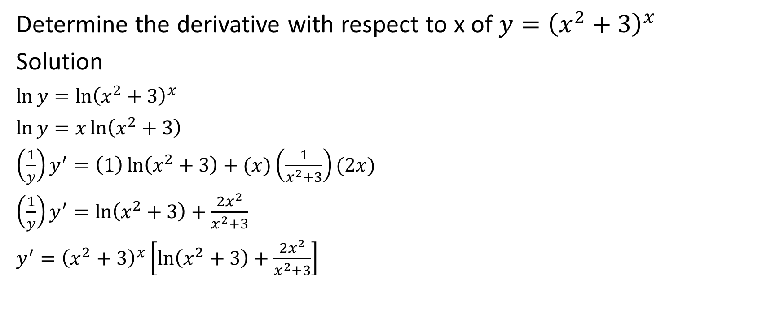
Determine the derivative with respect to x of $y={\left(x^{2}+3\right)}^{x}$
Solution
$\ln{y=\ln{{\left(x^{2}+3\right)}^{x}}}$
$\ln{y=x\ln\left(x^{2}+3\right)}$
$\left(\frac{1}{y}\right)y^{′}=\left(1\right)\ln\left(x^{2}+3\right)+(x)\left(\frac{1}{x^{2}+3}\right)(2x)$
$\left(\frac{1}{y}\right)y^{′}=\ln\left(x^{2}+3\right)+\frac{2x^{2}}{x^{2}+3}$
$y^{′}={\left(x^{2}+3\right)}^{x}\left[\ln\left(x^{2}+3\right)+\frac{2x^{2}}{x^{2}+3}\right]$

Slide 12
Sometimes logarithmic differentiation can be used to answer other questions where it might not necessarily be applicable.
We will prove the power rule using logarithmic differentiation in a moment, and then we will do an example where logarithmic differentiation is beneficial to a question that would otherwise be rather complicated.

Slide 13

Cool Example
Using logarithmic differentiation, prove the power rule; i.e. prove that if $f\left(x\right)=x^{n}$, then $f^{′}\left(x\right)=nx^{n−1}$.

Slide 14
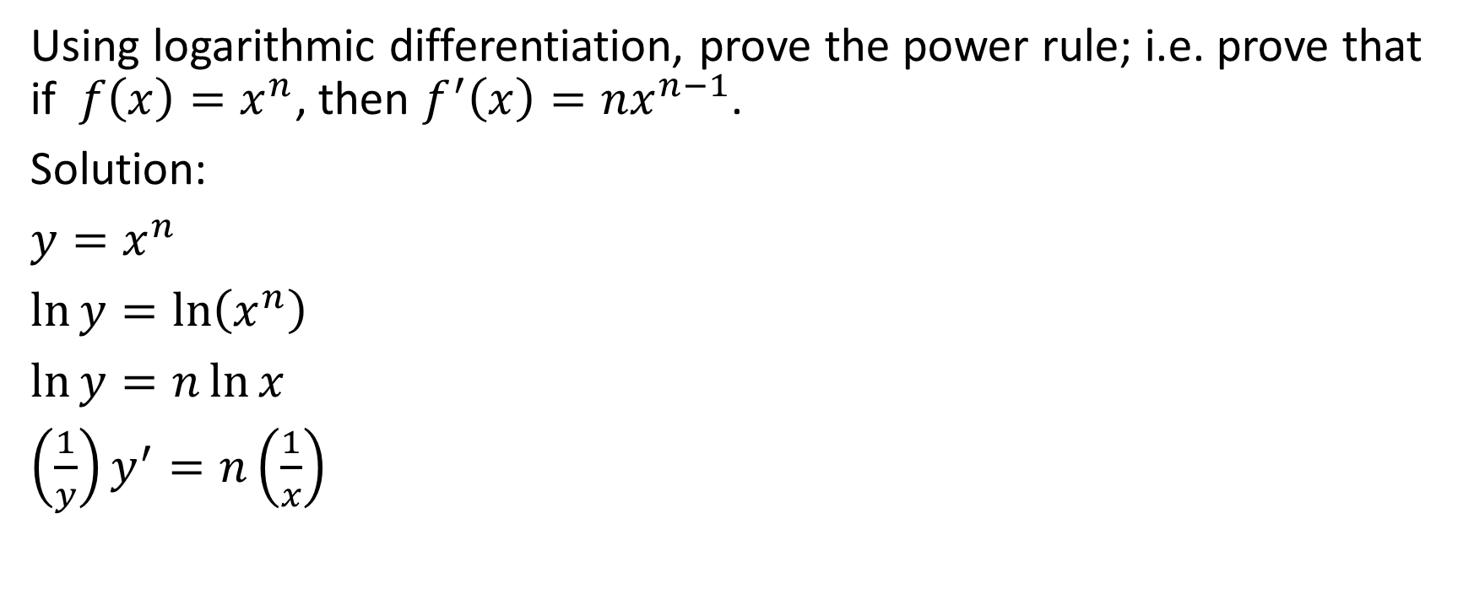
Using logarithmic differentiation, prove the power rule; i.e. prove that if $f\left(x\right)=x^{n}$, then $f^{′}\left(x\right)=nx^{n−1}$.
Solution:
$y=x^{n}$
$\ln{y=\ln\left(x^{n}\right)}$
$\ln{y=n\ln{x}}$
$\left(\frac{1}{y}\right)y^{′}=n\left(\frac{1}{x}\right)$

Slide 15

Using logarithmic differentiation, prove the power rule; i.e. prove that if $f\left(x\right)=x^{n}$, then $f^{′}\left(x\right)=nx^{n−1}$.
Solution:
$\left(\frac{1}{y}\right)y^{′}=n\left(\frac{1}{x}\right)$

Slide 16
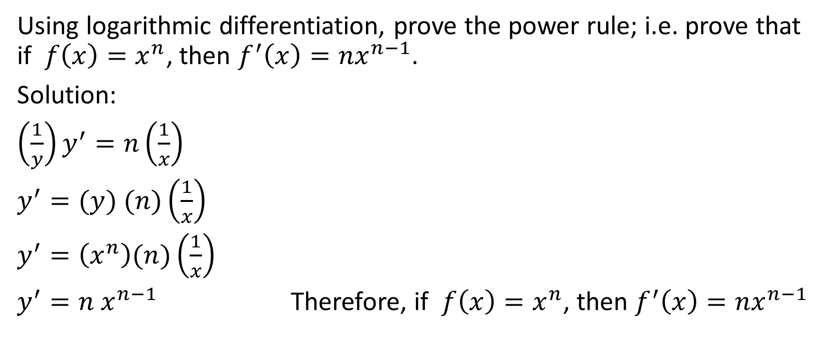
Using logarithmic differentiation, prove the power rule; i.e. prove that if $f\left(x\right)=x^{n}$, then $f^{′}\left(x\right)=nx^{n−1}$.
Solution:
$\left(\frac{1}{y}\right)y^{′}=n\left(\frac{1}{x}\right)$
$y^{′}=(y) (n)\left(\frac{1}{x}\right)$
$y^{′}=\left(x^{n}\right)(n)\left(\frac{1}{x}\right)$
$y^{′}=n x^{n−1}$ Therefore, if $f\left(x\right)=x^{n}$, then $f^{′}\left(x\right)=nx^{n−1}$

Slide 17

Example
Use logarithmic differentiation to evaluate $\frac{dy}{dx}$ at $x=−1$ given that
$y=\frac{\left(x^{4}+1\right)\sqrt{x+2}}{2x^{2}+2x+1}$

Slide 18
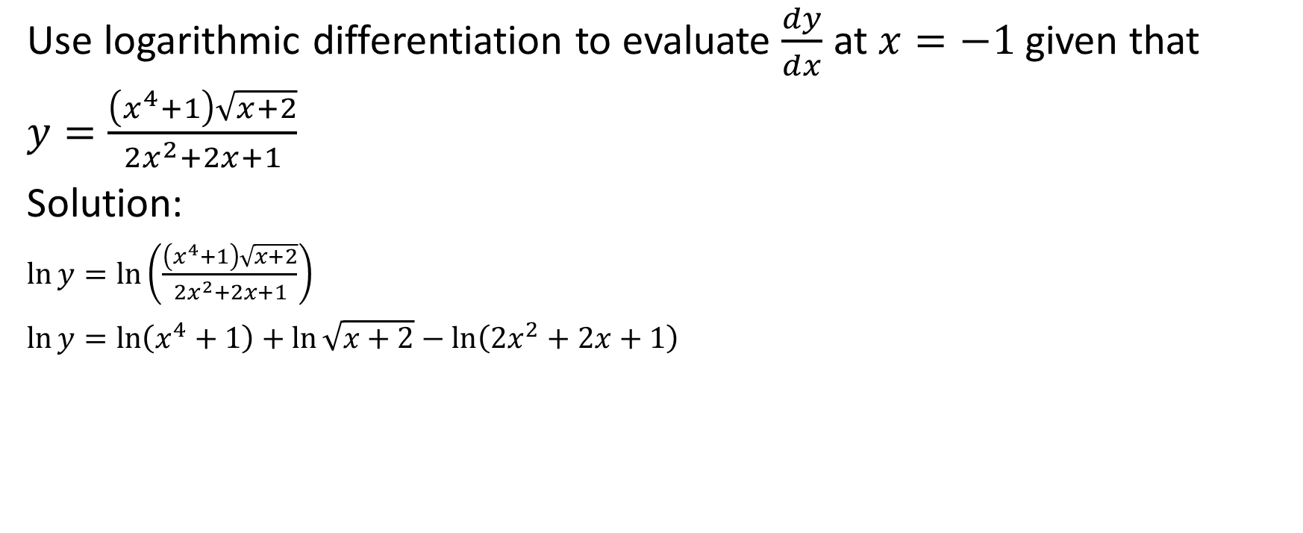
Use logarithmic differentiation to evaluate $\frac{dy}{dx}$ at $x=−1$ given that
$y=\frac{\left(x^{4}+1\right)\sqrt{x+2}}{2x^{2}+2x+1}$
Solution:
$\ln{y=\ln\left(\frac{\left(x^{4}+1\right)\sqrt{x+2}}{{2x}^{2}+2x+1}\right)}$
$\ln{y=\ln\left(x^{4}+1\right)+}$ $\ln{\sqrt{x+2}−\ln\left({2x}^{2}+2x+1\right)}$

Slide 19


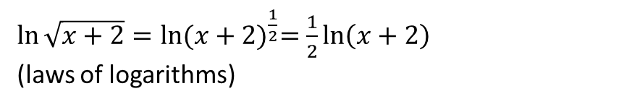
Use logarithmic differentiation to evaluate $\frac{dy}{dx}$ at $x=−1$ given that
$y=\frac{\left(x^{4}+1\right)\sqrt{x+2}}{2x^{2}+2x+1}$
Solution:
$\ln{y=\ln\left(\frac{\left(x^{4}+1\right)\sqrt{x+2}}{{2x}^{2}+2x+1}\right)}$
$\ln{y=\ln\left(x^{4}+1\right)+}$ $\ln{\sqrt{x+2}−\ln\left({2x}^{2}+2x+1\right)}$
$\ln{\sqrt{x+2}=\ln{{(x+2)}^{\frac{1}{2}}=\frac{1}{2}\ln\left(x+2\right)}}$
(laws of logarithms)

Slide 20
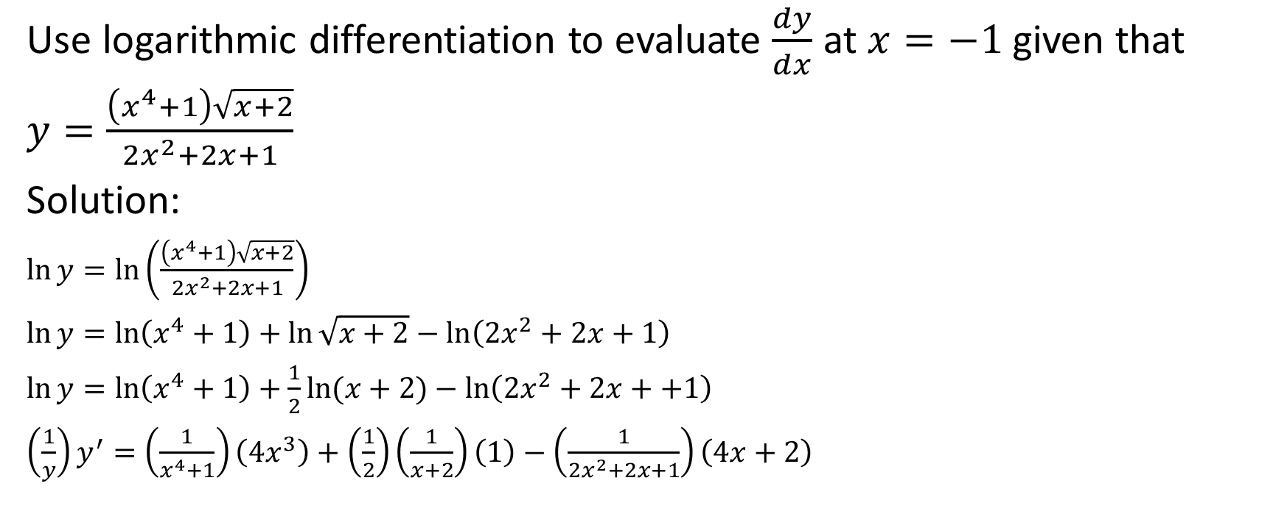
Use logarithmic differentiation to evaluate $\frac{dy}{dx}$ at $x=−1$ given that
$y=\frac{\left(x^{4}+1\right)\sqrt{x+2}}{2x^{2}+2x+1}$
Solution:
$\ln{y=\ln\left(\frac{\left(x^{4}+1\right)\sqrt{x+2}}{{2x}^{2}+2x+1}\right)}$
$\ln{y=\ln\left(x^{4}+1\right)+}$ $\ln{\sqrt{x+2}−\ln\left({2x}^{2}+2x+1\right)}$
$\ln{y=\ln\left(x^{4}+1\right)+\frac{1}{2}\ln{(x+2)}−\ln\left({2x}^{2}+2x++1\right)}$
$\left(\frac{1}{y}\right)y^{′}=\left(\frac{1}{x^{4}+1}\right)\left({4x}^{3}\right)+\left(\frac{1}{2}\right)\left(\frac{1}{x+2}\right)\left(1\right)−\left(\frac{1}{{2x}^{2}+2x+1}\right)\left(4x+2\right)$

Slide 21

Use logarithmic differentiation to evaluate $\frac{dy}{dx}$ at $x=−1$ given that
$y=\frac{\left(x^{4}+1\right)\sqrt{x+2}}{2x^{2}+2x+1}$
Solution:
$\left(\frac{1}{y}\right)y^{′}=\left(\frac{1}{x^{4}+1}\right)\left({4x}^{3}\right)+\left(\frac{1}{2}\right)\left(\frac{1}{x+2}\right)\left(1\right)−\left(\frac{1}{{2x}^{2}+2x+1}\right)\left(4x+2\right)$

Slide 22
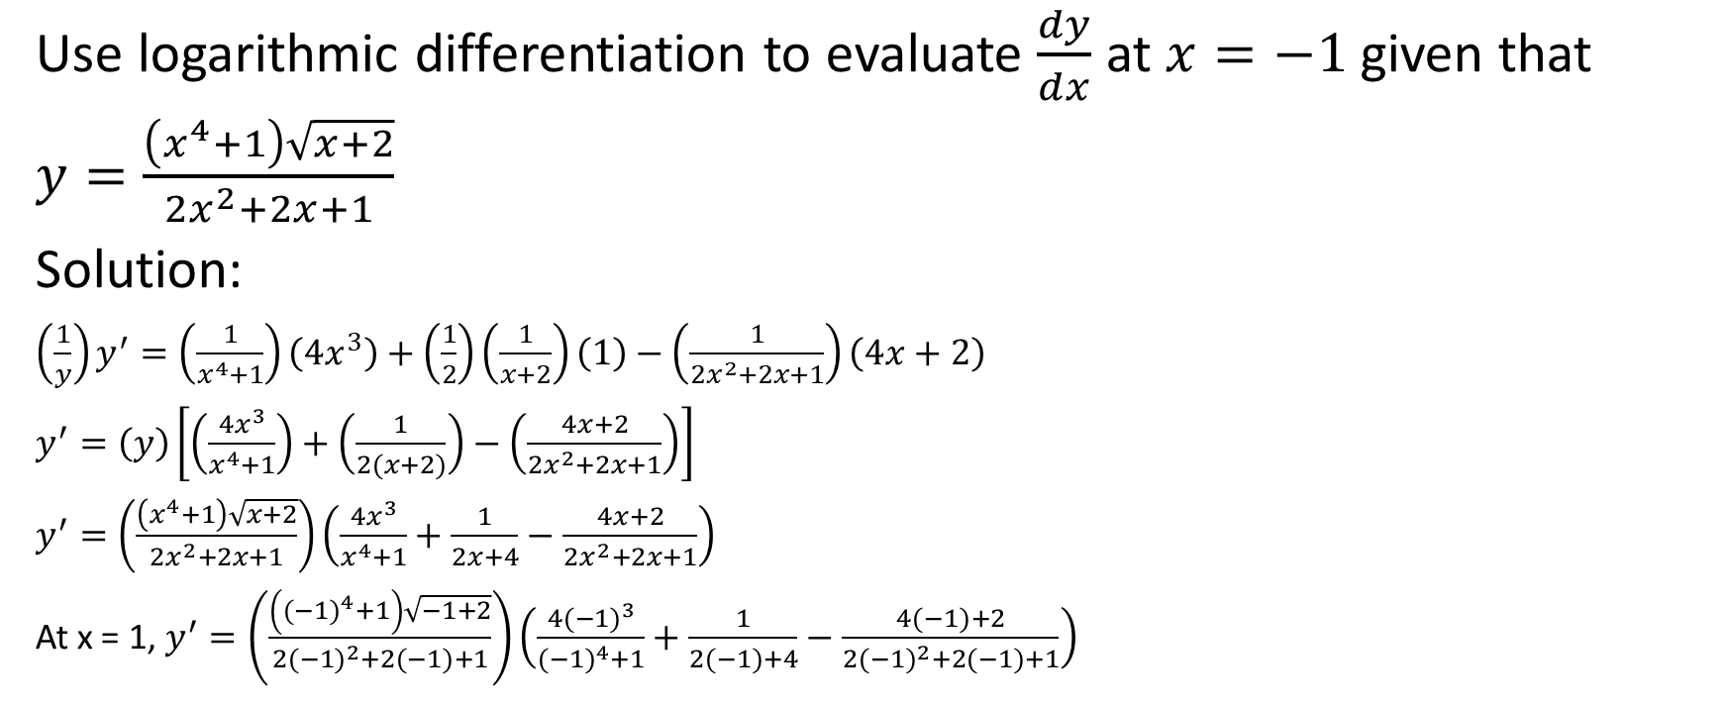
Use logarithmic differentiation to evaluate $\frac{dy}{dx}$ at $x=−1$ given that
$y=\frac{\left(x^{4}+1\right)\sqrt{x+2}}{2x^{2}+2x+1}$
Solution:
$\left(\frac{1}{y}\right)y^{′}=\left(\frac{1}{x^{4}+1}\right)\left({4x}^{3}\right)+\left(\frac{1}{2}\right)\left(\frac{1}{x+2}\right)\left(1\right)−\left(\frac{1}{{2x}^{2}+2x+1}\right)\left(4x+2\right)$
$y^{′}=\left(y\right)\left[\left(\frac{{4x}^{3}}{x^{4}+1}\right)+\left(\frac{1}{2(x+2)}\right)−\left(\frac{4x+2}{{2x}^{2}+2x+1}\right)\right]$
$y^{′}=\left(\frac{\left(x^{4}+1\right)\sqrt{x+2}}{2x^{2}+2x+1}\right)\left(\frac{{4x}^{3}}{x^{4}+1}+\frac{1}{2x+4}−\frac{4x+2}{{2x}^{2}+2x+1}\right)$
At x = 1, $y^{′}=\left(\frac{\left({(−1)}^{4}+1\right)\sqrt{−1+2}}{2{(−1)}^{2}+2(−1)+1}\right)\left(\frac{{4(−1)}^{3}}{{(−1)}^{4}+1}+\frac{1}{2(−1)+4}−\frac{4(−1)+2}{{2(−1)}^{2}+2(−1)+1}\right)$

Slide 23
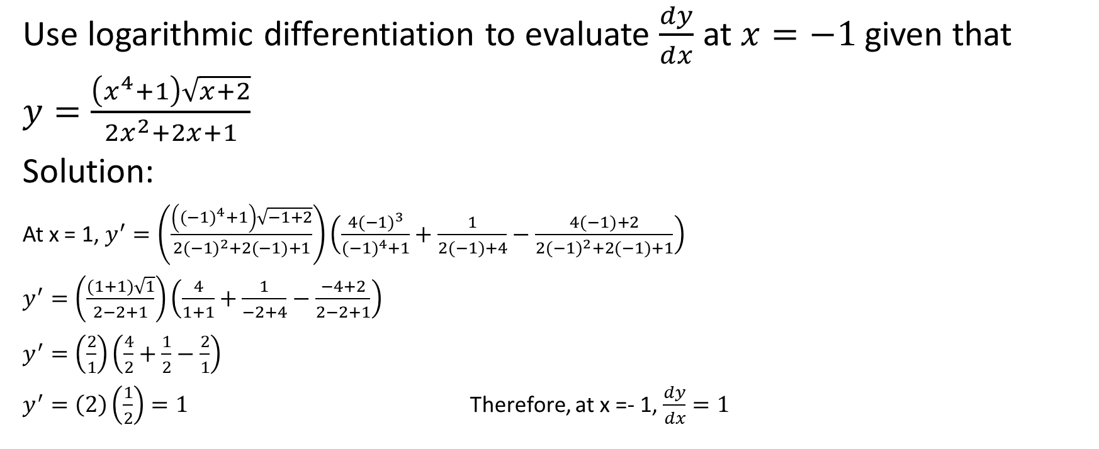
Use logarithmic differentiation to evaluate $\frac{dy}{dx}$ at $x=−1$ given that
$y=\frac{\left(x^{4}+1\right)\sqrt{x+2}}{2x^{2}+2x+1}$
Solution:
At x = 1, $y^{′}=\left(\frac{\left({(−1)}^{4}+1\right)\sqrt{−1+2}}{2{(−1)}^{2}+2(−1)+1}\right)\left(\frac{{4(−1)}^{3}}{{(−1)}^{4}+1}+\frac{1}{2(−1)+4}−\frac{4(−1)+2}{{2(−1)}^{2}+2(−1)+1}\right)$
$y^{′}=\left(\frac{(1+1)\sqrt{1}}{2−2+1}\right)\left(\frac{4}{1+1}+\frac{1}{−2+4}−\frac{−4+2}{2−2+1}\right)$
$y^{′}=\left(\frac{2}{1}\right)\left(\frac{4}{2}+\frac{1}{2}−\frac{2}{1}\right)$
$y^{′}=\left(2\right)\left(\frac{1}{2}\right)=1$ Therefore, at x =- 1, $\frac{dy}{dx}=1$

Slide 24
Another time when we use logarithmic differentiation is when we are given a logarithmic function in a base other than e (i.e., when we are not using the natural logarithm ln).
We will see that in these cases, we convert our logarithmic function equation to the equivalent exponential equation, and then use the natural logarithm.

Slide 25

Example
Determine $\frac{dy}{dx}$ given that $y=\log_{3}\left({4x}^{2}−5x+1\right)$

Slide 26
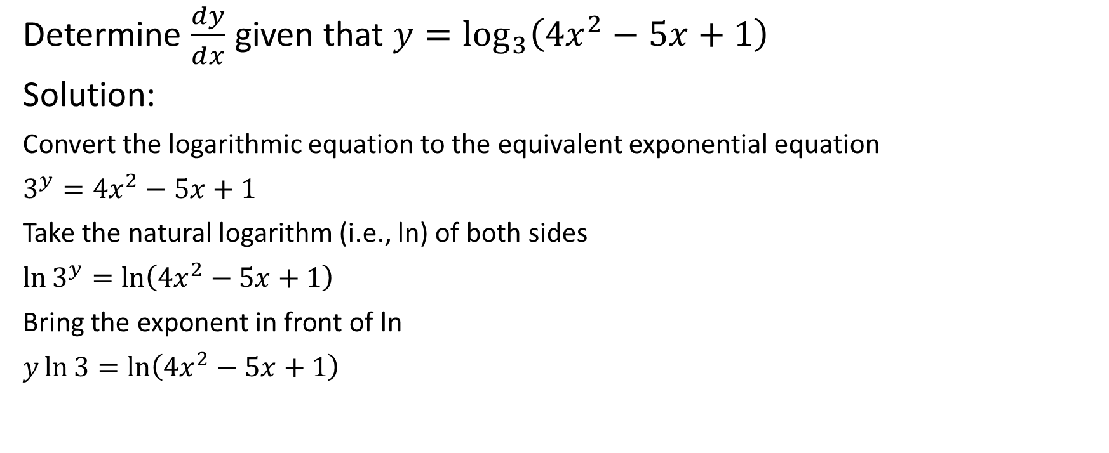
Determine $\frac{dy}{dx}$ given that $y=\log_{3}\left({4x}^{2}−5x+1\right)$
Solution:
Convert the logarithmic equation to the equivalent exponential equation
$3^{y}={4x}^{2}−5x+1$
Take the natural logarithm (i.e., ln) of both sides
$\ln{3^{y}=\ln\left({4x}^{2}−5x+1\right)}$
Bring the exponent in front of ln
$y\ln{3=\ln\left({4x}^{2}−5x+1\right)}$

Slide 27

Determine $\frac{dy}{dx}$ given that $y=\log_{3}\left({4x}^{2}−5x+1\right)$
Solution:
$y\ln{3=\ln\left({4x}^{2}−5x+1\right)}$

Slide 28
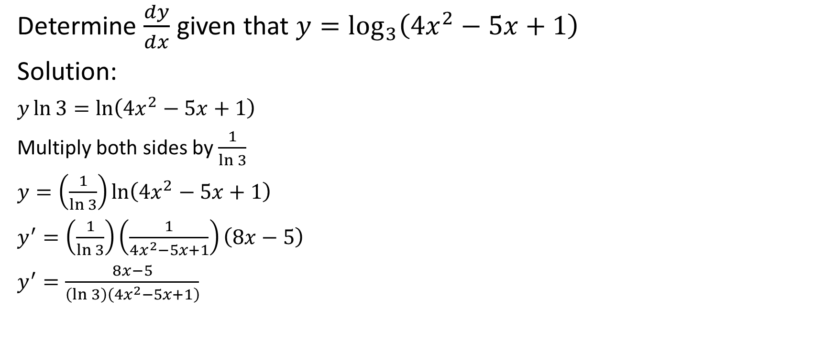
Determine $\frac{dy}{dx}$ given that $y=\log_{3}\left({4x}^{2}−5x+1\right)$
Solution:
$y\ln{3=\ln\left({4x}^{2}−5x+1\right)}$
Multiply both sides by $\frac{1}{\ln{3}}$
$y=\left(\frac{1}{\ln{3}}\right)\ln\left({4x}^{2}−5x+1\right)$
$y^{′}=\left(\frac{1}{\ln{3}}\right)\left(\frac{1}{{4x}^{2}−5x+1}\right)\left(8x−5\right)$
$y^{′}=\frac{8x−5}{\left(\ln{3}\right)\left({4x}^{2}−5x+1\right)}$

